Slide 1



Using OVS to Implement
High Performance NAT Gateway in Public Cloud Data Center
Yi Yang @ Inspur Cloud

Slide 2
Background
1
Inspur used firewalls from different vendors to implement NAT(including 1:1 NAT, SNAT, DNAT) and TC(traffic control/QoS) and Traffic Statistics before
Cloud Management Platform has to program backend to adapt to every kind of firewall, this is time-consuming, valueless and endless.
Why not do it by ourselves? Some concerns (performance, stability, reliability, scalability, HA/Clustering)
No existing opensource project does this.
OVS/OVS DPDK or Linux system itself can do this(total internet bandwidth is 3Gbps, 3 BGP lines, China Telecom, China Unicom, China Mobile)

Slide 3
Why do we choose OVS/OVS DPDK?
2
Actually Linux also can do these things: iptables for NAT, tc for traffic control and statistics
But OVS is more flexible and more scalable, openflow can do all these things
To be important, userspace conntrack implementation in OVS DPDK should be able to maximize NAT performance when total internet bandwidth increases later (Maybe >= 10Gbps)
meter action is much simpler than tc qdisc & fliter for traffic QoS

Slide 4



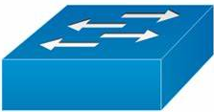
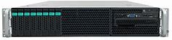
Deployment Topology (Baremetal)
3
China Telecom
China Unicom
Internet
China Mobile
Openstack
Infrastructure
VM accesses Internet: VMIP -> FIP -> EIP
Internet Client accesses VM: EIP -> FIP -> VMIP
NAT Gateway
master
NAT Gateway
slave
VM

Slide 5
Deployment Topology (VM)
4
China Telecom
3
China Unicom
Internet
China Mobile
Openstack
Infrastructure
VM accesses Internet: VMIP -> FIP -> EIP
Internet Client accesses VM: EIP -> FIP -> VMIP
NAT Gateway
Master
VM
NAT Gateway
Slave
VM
VM

Slide 6
Features of Inspur NAT Gateway/EIP Cluster
5
1:1 NAT
N:1 SNAT
N:1 DNAT
QoS per EIP
Shared Qos For Multiple EIPs
HA: master slave
Hairpin support for EIP to EIP traffic
Unified CLI for NAT, SNAT, DNAT, Qos, SQoS, traffic statistics and monitoring

Slide 7
Hairpin traffic issue
6
compute 1
VM1
NAT Gateway
master
Internet
When the packet arrives at this router:
source IP: EIP1: 10.110.61.5
destination IP: EIP2: 10.110.61.10
sip and dip are in the same subnet, so this route can’t route it into its ingress interface.
The result is EIP2 is unreachable.
VMIP1: 192.168.254.10
FIP1: 172.16.33.5
EIP1: 10.110.61.5
compute 2
VM2
VMIP2: 192.168.254.12
FIP2: 172.16.33.10
EIP2: 10.110.61.10

Slide 8
Solution to Hairpin traffic issue
7
compute 1
VM1
1
4
NAT Gateway
master
2
2
3
4
VMIP1 EIP2
2
1
SIP: 192.168.254.10, DIP: 10.110.61.10
NAT
FIP1 EIP2
2
SIP: 172.16.33.5, DIP: 10.110.61.10
VMIP1: 192.168.254.10
FIP1: 172.16.33.5
EIP1 EIP2
EIP1: 10.110.61.5
3
SIP: 10.110.61.5, DIP: 10.110.61.10
compute 2
EIP1 FIP2
VM2
6
4
SIP: 10.110.61.5, DIP: 172.16.33.10
5
EIP1 VMIP2
5
SIP: 10.110.61.5, DIP: 192.168.254.12
VMIP2: 192.168.254.12
FIP2: 172.16.33.10
EIP2: 10.110.61.10

Slide 9
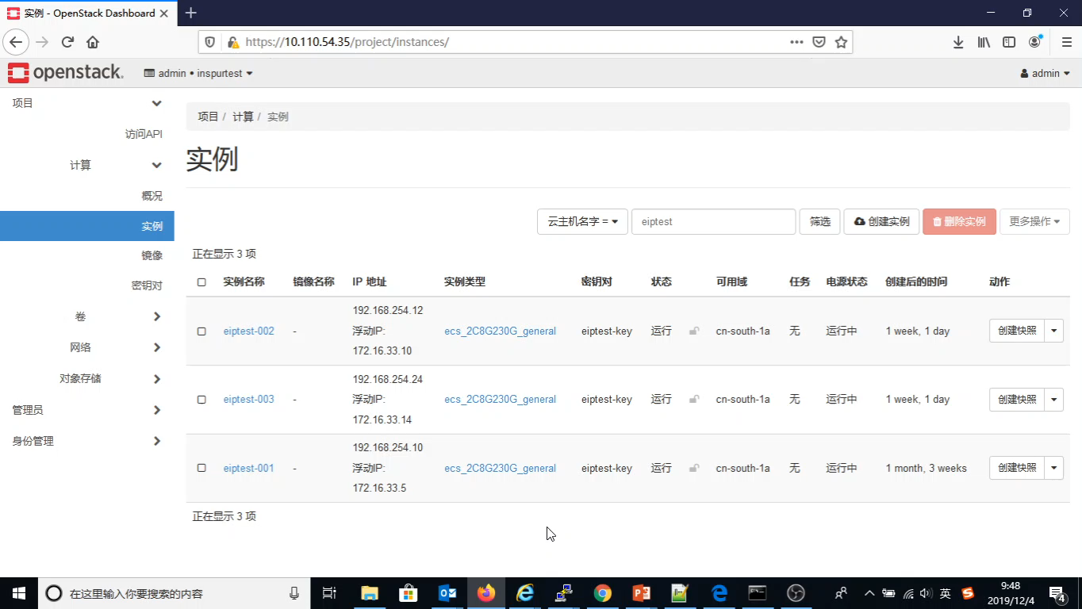
Hairpin traffic solution demo
8

Slide 10
NAT gateway CLI
9
Usage: eipadmin add|del|update|stat|monitor <FIP>[:<FIP_PORT>] <EIP>[:<EIP_PORT] nat|snat|qos|sqos <ratelimit> <name>|tcp|udp
eipadmin add 192.168.200.101 117.73.1.87 nat
eipadmin del 192.168.200.101 117.73.1.87 nat
eipadmin add 192.168.200.200/24 117.73.1.200 snat
eipadmin del 192.168.200.200/24 117.73.1.200 snat
eipadmin add 0.0.0.0 117.73.1.200 qos <ratelimit>
eipadmin del 0.0.0.0 117.73.1.200 qos <ratelimit>
eipadmin update 0.0.0.0 117.73.1.200 qos <ratelimit>
eipadmin add 0.0.0.0 117.73.1.200 sqos <ratelimit> <name>
eipadmin del 0.0.0.0 117.73.1.200 sqos <ratelimit> <name>
eipadmin update 0.0.0.0 0.0.0.0 sqos <ratelimit> <name>
eipadmin stat 0.0.0.0 117.73.1.200 qos
eipadmin stat 0.0.0.0 0.0.0.0 sqos <ratelimit> <name>
eipadmin monitor 0.0.0.0 117.73.1.200 qos
eipadmin monitor 0.0.0.0 0.0.0.0 sqos <ratelimit> <name>
eipadmin add 192.168.200.200:<fip_port> 117.73.1.200:<eip_port> dnat <ratelimit> tcp|udp
eipadmin del 192.168.200.200:<fip_port> 117.73.1.200:<eip_port> dnat <ratelimit> tcp|udp

Slide 11
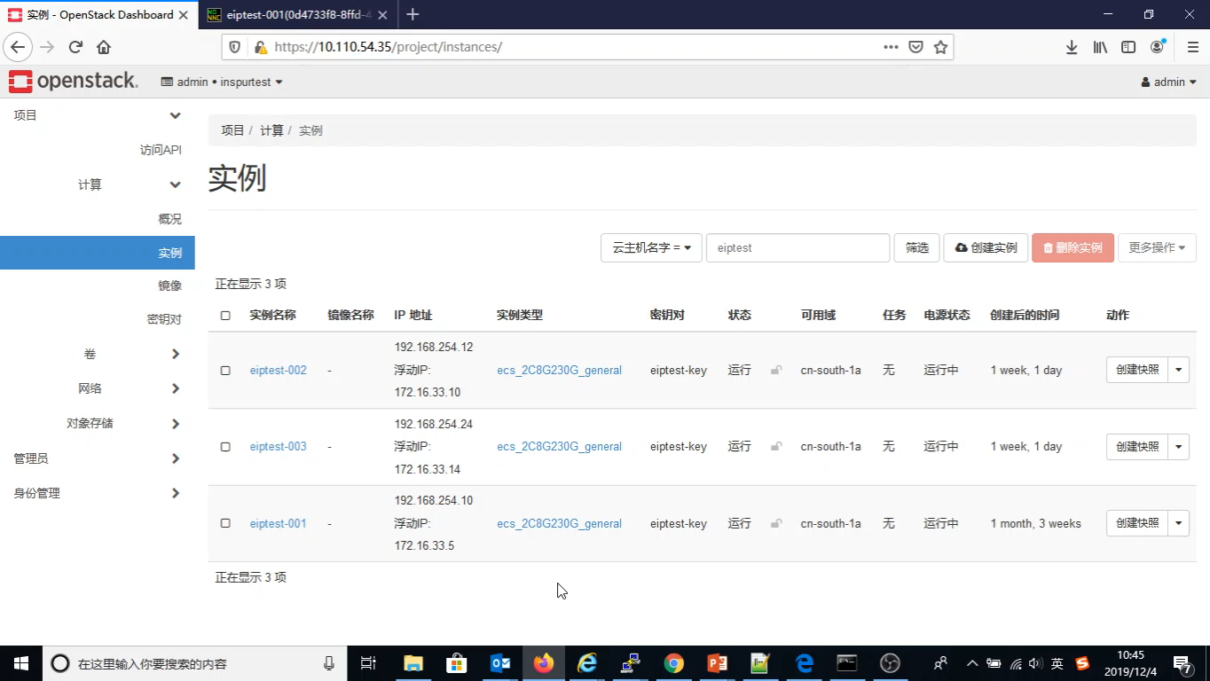
NAT Gateway Demo
10

Slide 12
Challenges
11
1:N SNAT, N EIPs are from 3 telecom carriers, not consecutive
Active active mode
Connection state synchronization: any existing connection will be broken when one NAT gateway transitions to slave state from master.
Conntrack state tables synchronization for active active mode
Load balancing for NAT gateways in active active mode
Horizontal Scalability: multiple NAT gateways in active and active mode and traffic can be evenly distributed into every NAT gateway, any NAT gateway node failure won’t impact on any current existing connection.

